Slide 1

Database System Report #1 Logical Design of a Shopping Mall Database (ERD Example)
Juhyun Lee Department: AI and Data Science
This report was my first logical database design project, created as part of a course at Korea Cyber University. It models a shopping mall system using an Entity-Relationship Diagram (ERD). It was an enjoyable and valuable experience that allowed me to apply theoretical concepts to a practical scenario.

Slide 2

Assignment Prompt
Based on the data requirements,
design an ERD (Entity-Relationship Diagram). Complete each step below and provide a short explanation for each.
📌 Step 1: Entity Selection
Identify and list the entities in the database.
📌 Step 2: Define Relationships
Establish and describe the relationships among entities.
📌 Step 3: Create Skeleton ERD
Draft the basic ERD structure showing entities and relationships.
📌 Step 4: Add Attributes
Assign attributes to each entity in the diagram.
📌 Step 5: Complete the ERD
Finalize the full ERD including primary and foreign keys.
✅ Note: You may assume and add any additional conditions or scenarios as needed. Please include explanations below the ERD.

Slide 3
Data Requirements
The goal is to build a database for an online shopping mall. Based on requirement analysis, the following points have been identified:
The database should contain product information and customer order details.
A customer can order multiple products at once, including multiple quantities of the same product.
Manufacturers create products and supply them according to delivery dates. The supply price is managed separately from the sales price.
Each employee is responsible for a manufacturer and regularly inspects products produced by that manufacturer.
Product information includes name, description, sales price, manufacturer, manufacture date, and expiration date.
Each product belongs to a specific category (e.g., office equipment, electronics, food, kitchenware, etc.).
Manufacturer information includes manufacturer ID, company name, address, postal code, main phone number, homepage, and email.
Customer information includes name, phone numbers (home and mobile), address, and date of birth.
Customers' occupation data is also managed for regular sales analysis by occupation.
Employee information includes employee ID, name, gender, department (sales), and year of hire.

Slide 4
1. Entity Selection
Product
A physical entity that needs to be maintained and managed in business operations. Attributes are derived based on data requirement #5.
Customer
A physical entity that must be maintained in business processes, with attributes based on data requirement #8.
Employee
A physical entity relevant to business operations, with attributes identified through data requirement #10.
Manufacturer
A physical entity involved in production and supply, with required attributes from data requirement #7.
Occupation(Weak Entity)
Included to enable periodic sales analysis by occupation as outlined in data requirement #9. It is considered a weak entity because it is only meaningful in connection with a customer.

Slide 5
2. Relationship Design
Order (Customer ↔ Product)
Cardinality: N:M
I considered using a weak entity (e.g., OrderDetail) to store quantity or packaging, but based on requirement #2, I modeled it directly as N:M.
Supply (Manufacturer → Product)
Cardinality: 1:N
One manufacturer supplies multiple products.
Assignment (Employee → Manufacturer)
Cardinality: 1:N
One employee manages multiple manufacturers.
Inspection (Employee → Product)
Cardinality: 1:N Employees inspect products made by their assigned manufacturers.
Management (Employee → Manufacturer)
Cardinality: 1:N Employees manage information about assigned manufacturers.
Works In (Customer → Occupation)
Cardinality: 1:1 Occupation is a weak entity dependent on Customer.

Slide 6
3. Draft ERD Diagram
Occuptation
Employee
N
1
Inspect
1
Work
N
1
Product
Assign
Management
1
M
Customer
N
Order
M
supplies
N
N
N
Manufacturer

Slide 7
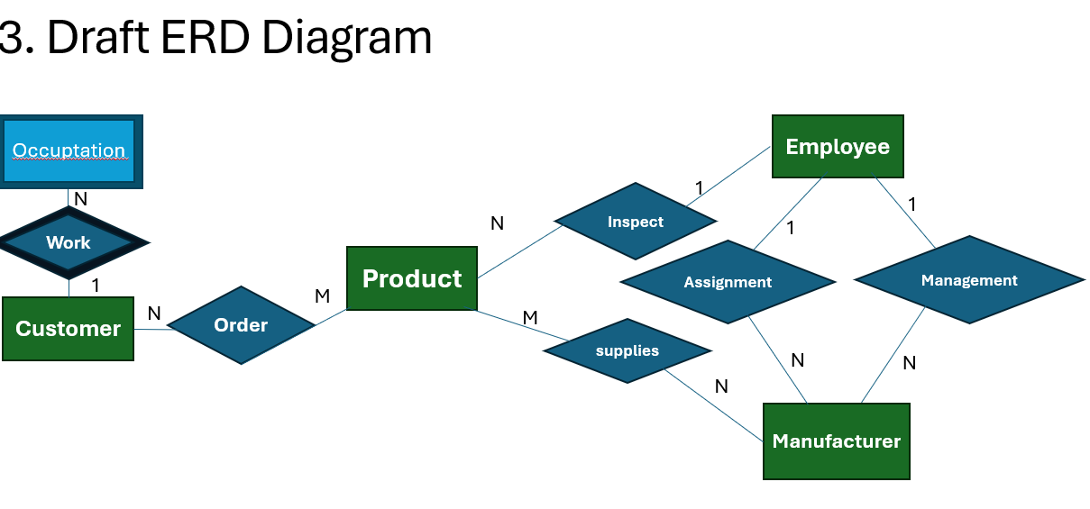

Slide 8
4. Attribute Assignment
Attributes were assigned based on data requirements. Primary keys were added as needed, and multivalued attributes were noted.
Product
ProductID (PK), Name, Description, Sales Price, Manufacturer, Manufacture Date, Expiration Date, Category (multivalued)
Manufacturer
ManufacturerID (PK), Company Name, Address, Postal Code, Main Phone Number, Website, Email
Customer
CustomerID (PK), Name, Phone Number (home/mobile), Address, Date of Birth
Employee
EmployeeID (PK), Name, Gender, Department (assumed single attribute), Year of Joining
Occupation (Weak Entity)
OccupationID (Partial Key), CustomerID (FK), Job Type, Experience Income was excluded for privacy reasons, but can be inferred from other attributes.

Slide 9
5. Completed ERD
Name
Sex
Depart-ment
Employee
Number
Year of Joining
Employee
Customer ID
1
Inspect
Name
N
1
1
Customer
N
Order
M
Product
Assigned
to
Phone Number
Manage
Manufacturer
ID
Address
M
Supply
Birth Date
work
N
N
N
Company Name
Address
Category
Delivery
Date
Supply Price
Manufacturer
Zip Code
Occupation
Product ID
Main Contact Number
Name
Sales Price
Occupation ID
Job Type
Experi-ence
Manufacture Date
Website
description
Manufa-cturer
Expire Date
Email

Slide 10
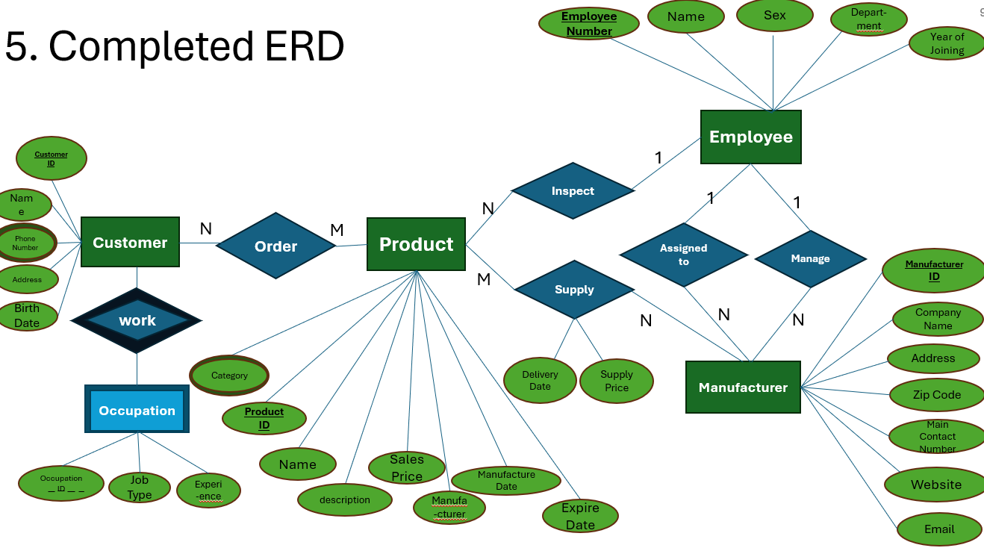
*Just in case the PowerPoint formatting breaks, I added a screenshot.

